Slide 1

NSG Pilkington – University of Liverpool Machine Learning Project: 30/09/2020
Dr. Peter Green
Diego Echeverria
Risk Institute,
School of Engineering

Slide 2
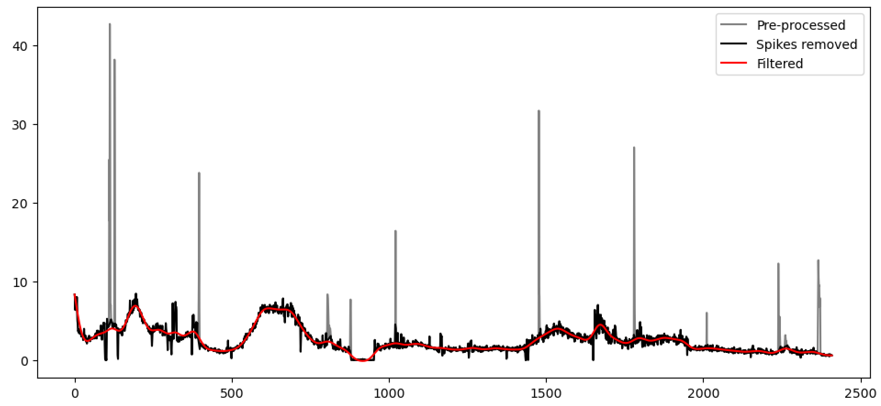
Removal of Spikes from Furnace Faults Data
A note on error metrics; will now have to use Root Mean-Squared Error (unnormaliesd) as we have regions where the furnace faults are very close to zero.

Slide 3
The previous approach: Training
Fault
Density
lag
Time
Tag 1
Time
Tag 2
Time

Slide 4
The previous approach: Training
Fault
Density
lag
The previous approach assumed that the model input is made up of all tags at the same time lag.
Time
Tag 1
Time
Tag 2
Time

Slide 5
Max lag
Fault
Density
The model input is made up of tags at different time lags
Time
Min lag
Tag 1
Time
Tag 2
Time

Slide 6
Max lag
Fault
Density
The model input is made up of tags at different time lags
Time
Min lag
Tag 1
Time
Tag 2
Time

Slide 7
Max lag
Fault
Density
The model input is made up of tags at different time lags
Time
Min lag
Tag 1
Time
Tag 2
Time

Slide 8
Max lag
Fault
Density
Note that we have some inputs whose time lags are less than ‘Min lag’. For now, we’ve simply removed them from the analysis but they could be included later.
Time
Min lag
Tag 1
Time
Tag 2
Time

Slide 9
Example Results (15 hours)
(Video 1)

Slide 10
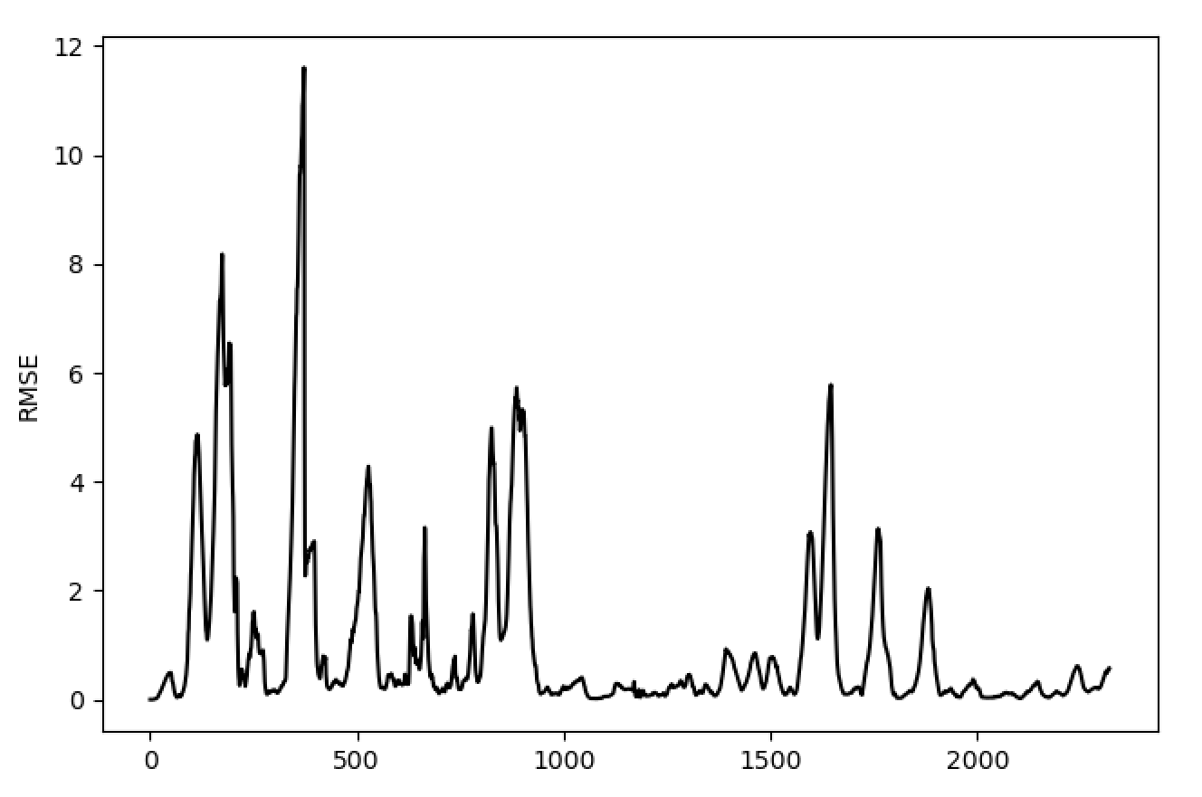
Example Results (15 hours)

Slide 11
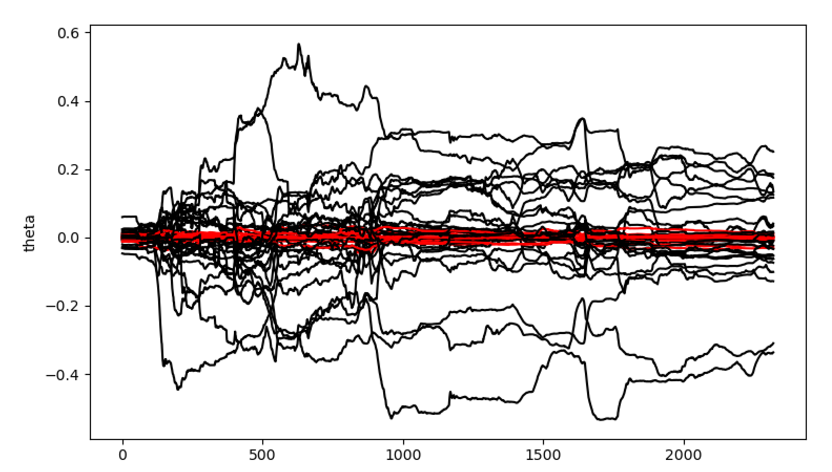
Example Results (15 hours)
Shown in red are thetas whose absolute values were never more than 0.05.

Slide 12
Example Results (15 hours)
Inputs whose absolute parameters were never larger than 0.05:
11132 Port 8 Combustion Air Flow RHS (OP)
11201 Furnace & Services Pack Sub S8 L.H. Section - HV13
135 Total Firm Gas Flow Measurement
136 Total Combustion Air Flow Measurement
15119 Furnace Pressure (PV)
30060 U/S Flowing End Air Flow Measurement
6310 Cooling Water Flow - Furnace RHS
6400 Furnace Compressed Air Flow Measurement
6463 Main Gas Pressure (PV)
6469 Furnace Pressure Meas. on Crown
6585 Port 6 Gas Flow (PV)
7434 Cooling Water Flow - Furnace LHS
7474 Lehr Drive Line Shaft Speed
7667 Port 7 Gas Flow (PV)
7746 Open Crown Temperature - Port 2 (PV)
8344 Total CCCW Flow Measurement

Slide 13
Example Results (15 hours)
Inputs whose absolute parameters were never larger than 0.05:
11132 Port 8 Combustion Air Flow RHS (OP)
11201 Furnace & Services Pack Sub S8 L.H. Section - HV13
135 Total Firm Gas Flow Measurement
136 Total Combustion Air Flow Measurement
15119 Furnace Pressure (PV)
30060 U/S Flowing End Air Flow Measurement
6310 Cooling Water Flow - Furnace RHS
6400 Furnace Compressed Air Flow Measurement
6463 Main Gas Pressure (PV)
6469 Furnace Pressure Meas. on Crown
6585 Port 6 Gas Flow (PV)
7434 Cooling Water Flow - Furnace LHS
7474 Lehr Drive Line Shaft Speed
7667 Port 7 Gas Flow (PV)
7746 Open Crown Temperature - Port 2 (PV)
8344 Total CCCW Flow Measurement
Repeating the analysis with these inputs removed…

Slide 14
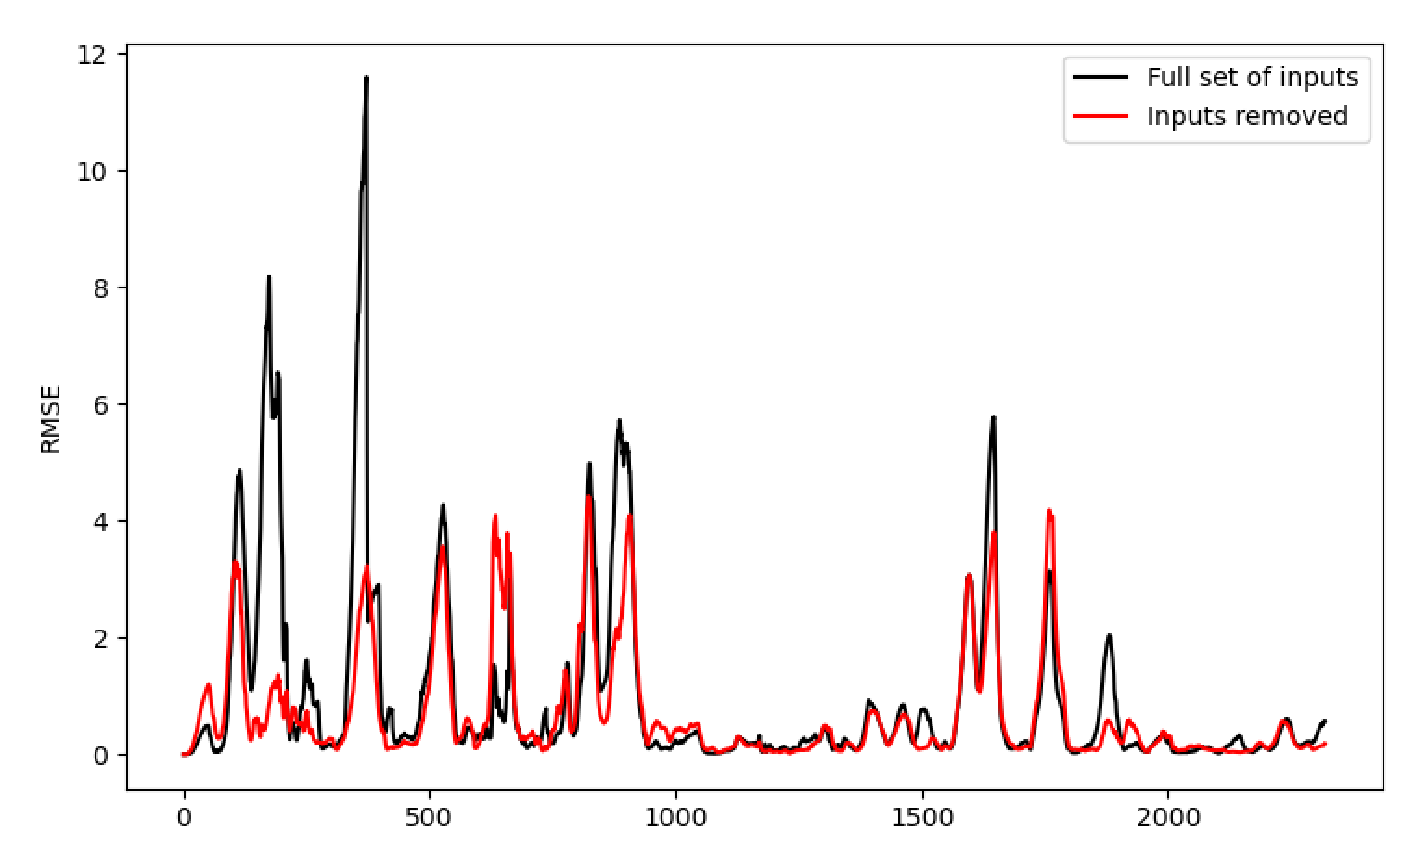
Example Results (15 hours, with inputs removed)

Slide 15
Example Results (15 hours, with inputs removed)
(Video 2)

Slide 16
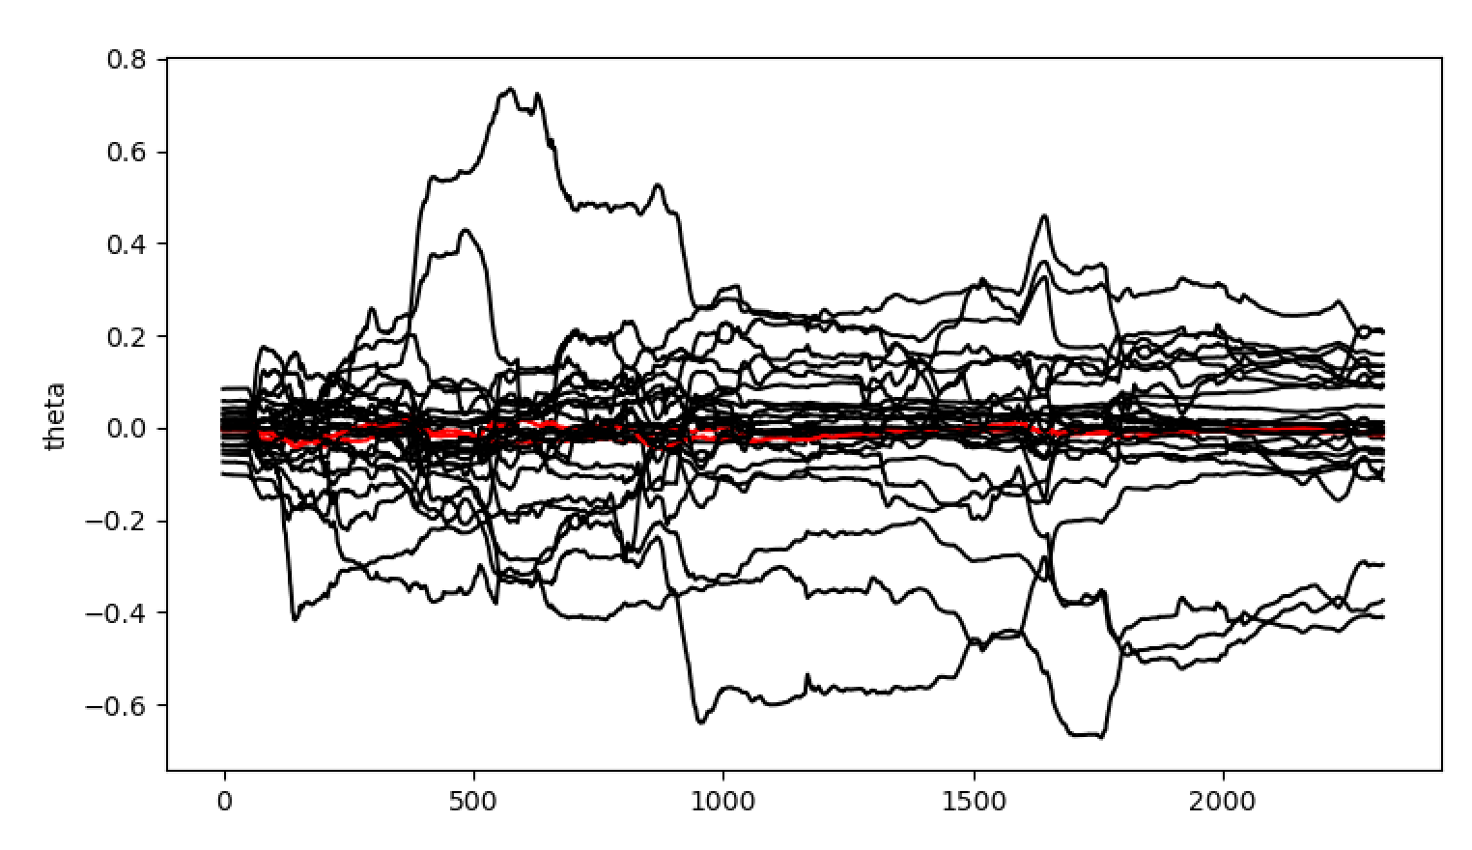
Example Results (15 hours, with inputs removed)
Possible scope for removing more? We haven’t done so yet but could certainly try it

Slide 17
Max lag
Fault
Density
Time
Min lag
Tag 1
Time
Tag 2
Time

Slide 18
Max lag
An auto-regressive model also include previously observed furnace faults as an input
Fault
Density
Time
Min lag
Tag 1
Time
Tag 2
Time

Slide 19
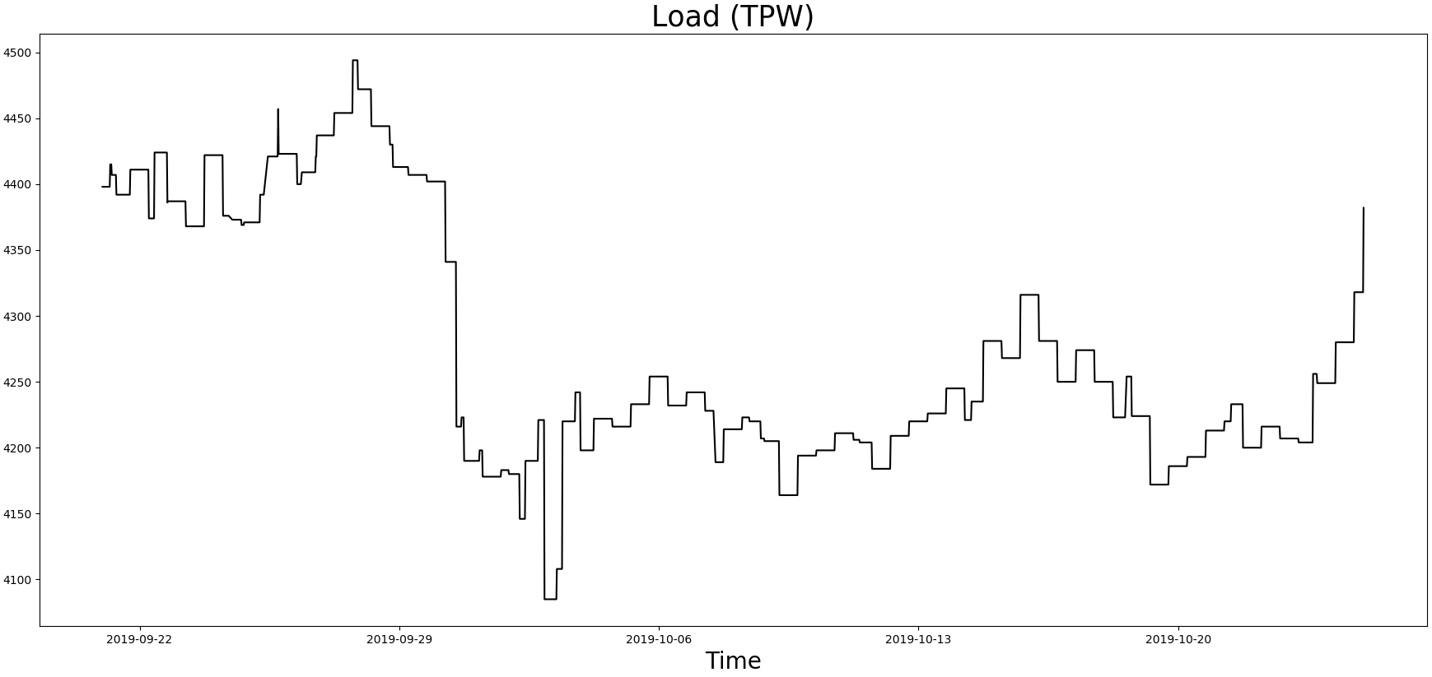
How the campaign data changed from 21/09/19 to 25/10/19
Note: The Campaign data has not yet been used as model input

Slide 20
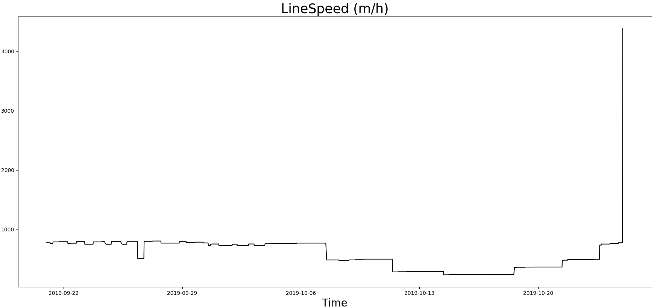
How the campaign data change from 21/09/19 to 25/10/19
Note: The Campaign data has not yet been used as model input

Slide 21
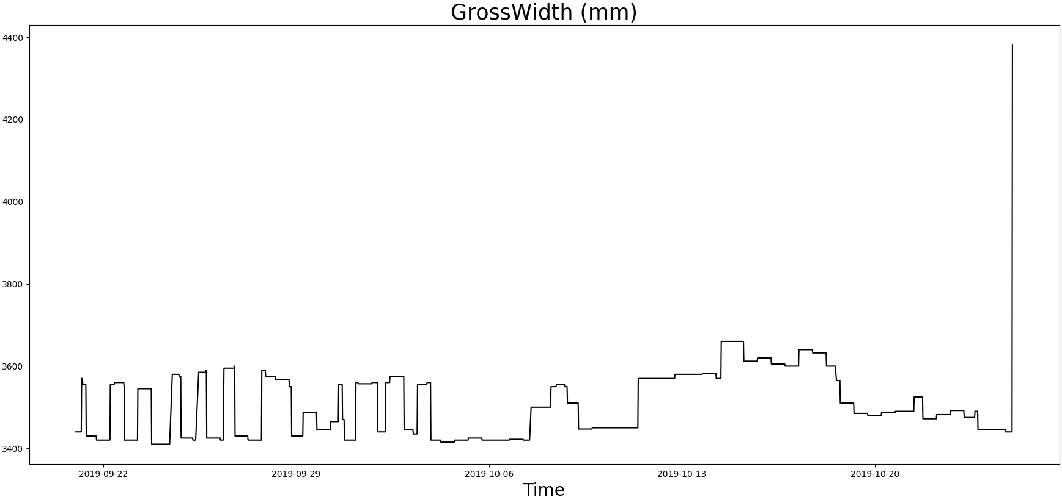
How the campaign data change from 21/09/19 to 25/10/19
Note: The Campaign data has not yet been used as model input

Slide 22
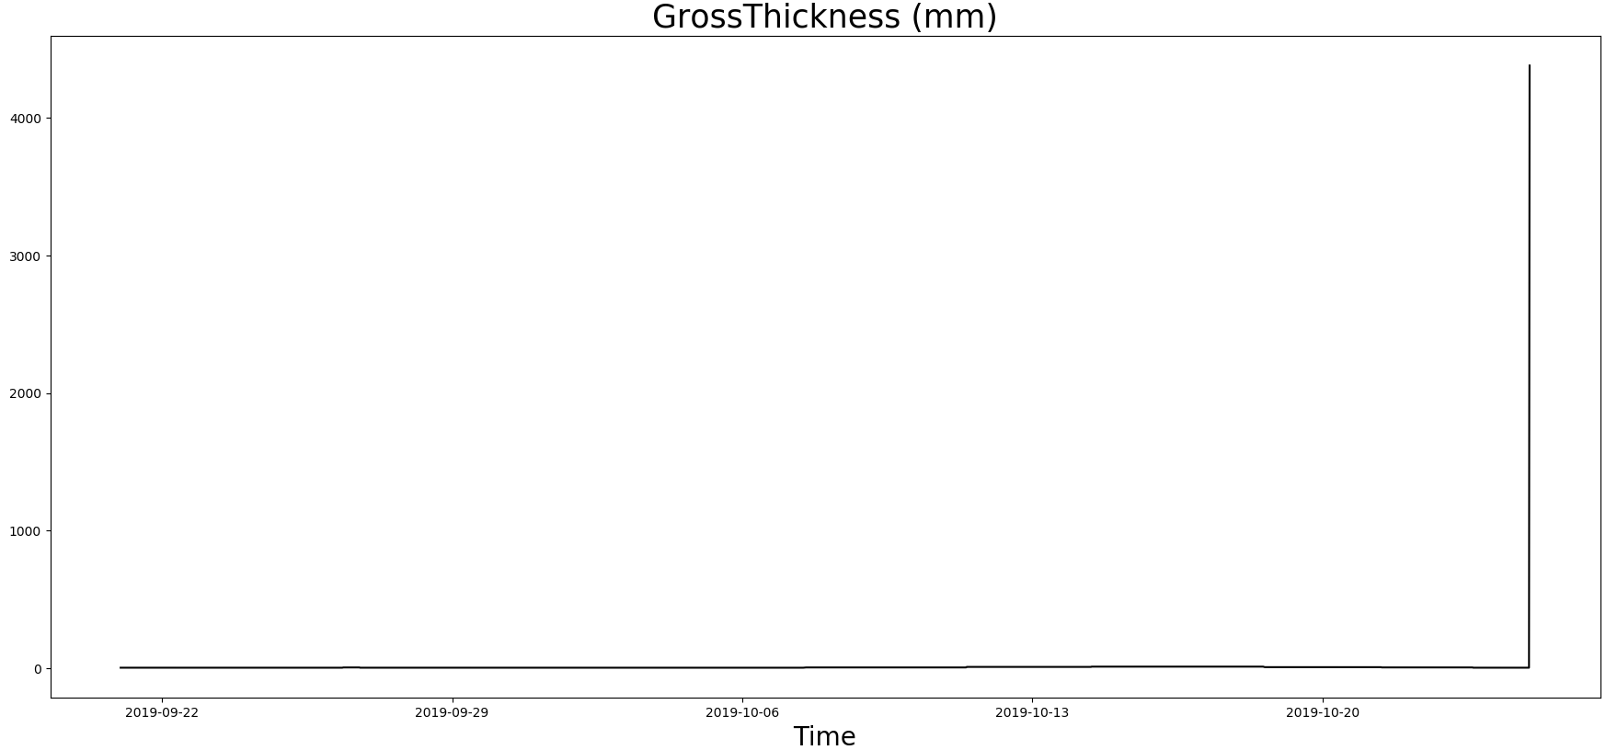
How the campaign data change from 21/09/19 to 25/10/19
Note: The Campaign data has not yet been used as model input

Slide 23
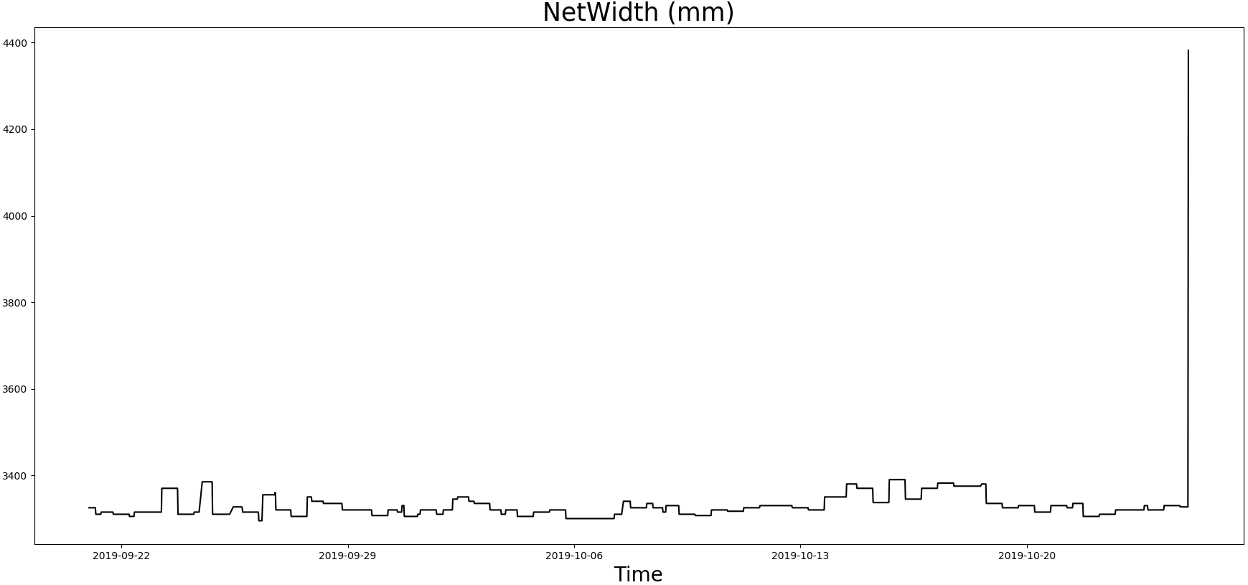
How the campaign data change from 21/09/19 to 25/10/19
Note: The Campaign data has not yet been used as model input

Slide 24
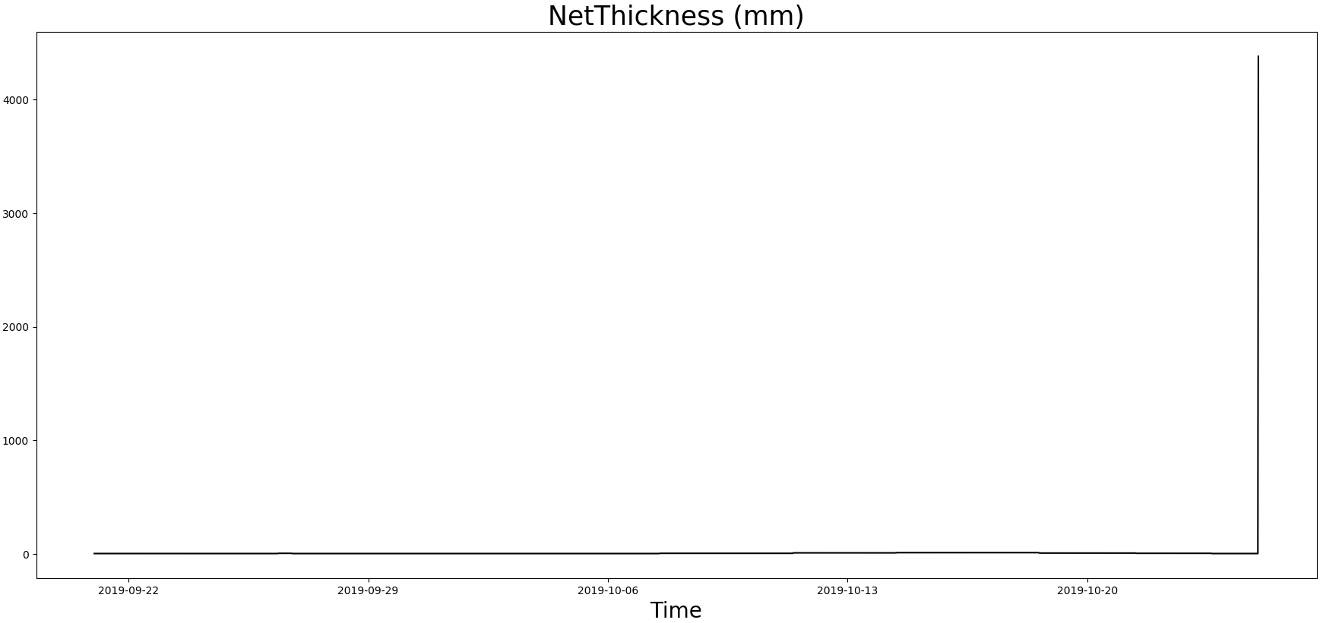
How the campaign data change from 21/09/19 to 25/10/19
Note: The Campaign data has not yet been used as model input

Slide 25

How the campaign data change from 21/09/19 to 25/10/19
Note: The Campaign data has not yet been used as model input

Slide 26
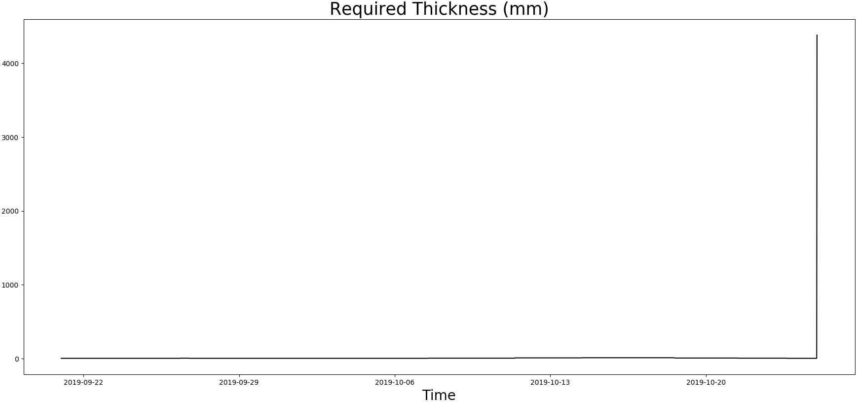
How the campaign data change from 21/09/19 to 25/10/19
Note: The Campaign data has not yet been used as model input

Slide 27
Next Steps
Campaign data, showing where changes in product occurred overlayed with plots.
Potential improvements from auto-regressive model structure.
Other possible next options:
Principal Component Analysis (dimensionality reduction technique)
Nonlinear model structure
But perhaps it’s best to review the signal processing that is taking place on our remaining inputs first.
Still scope to remove more input parameters too.

Slide 28
Thank you for your attention. ANY QUESTIONS?

